Slide 1

LOAN APPROVAL PREDICTIVE MODEL
Andrew Liu 100390239​
Aswinee Rath 100389210​
Patrick Ipac 100385706

Slide 2
AGENDA
PROJECT BACKGROUND
EXPLORATORY DATA ANALYSIS(EDA) AND CLEANUP
VARIABLE SELECTION
LOGISTIC & INTERACTION MODEL
MODEL COMPARISON
CONCLUSION

Slide 3
AGENDA
PROJECT BACKGROUND
EXPLORATORY DATA ANALYSIS(EDA) AND CLEANUP
VARIABLE SELECTION
LOGISTIC & INTERACTION MODEL
MODEL COMPARISON
CONCLUSION

Slide 4
PROJECT BACKGROUND
Loan Approval Analysis (https://www.kaggle.com/datasets/yasserh/loan-default-dataset)​
Historical data of loan applicants​
Enormous dataset - 148670 observation of 34 variables:​
Multiple deterministic factors (e.g. borrower's income, gender, loan purpose, etc. ​)
Subject to strong multicollinearity & empty/missing values.

Slide 5
PROJECT BACKGROUND
Original dataset Total 148670 rows, 34 variables
VARIABLES | DESCRIPTION
ID | Business_or_Commercial | Property_value | Submission_of_application
Year | Loan_Amount | Construction_type | Life-time Value(LTV)
Loan Limit | Rate_of_interest | Occupancy_type | Region
Gender | Interest_rate_spread | Secured_by | Security_Type
Approv_in_adv | Upfront_charges | Total_units | Status
Loan_type | Term | Income | Debt-to-income ratio (dtir1)
Loan_purpose | Neg_amortization | Credit_type
Credit_Worthiness | Interest_only | Co-applicant_credit_type
Open_Credit | Lump_sum_payment | Age

Slide 6
PROJECT BACKGROUND
EXPLANATORY VARIABLES | DESCRIPTION
Loan_type | Type of loan taken
Loan_amount | Exact loan amount
Rate_of_interest | amount a lender charges a borrower (% of the principal—the amount loaned.)
Term | Loan repayment period
Property_value | Present worth of future benefits arising from property ownership
Income | Amount of money, property, and other transfers of value received over a set period
Credit_Score | Prediction of credit behavior
Age | Current age of borrower
Debt-to-income ratio (dtir1) | % of income over % of debt ; good measure of borrowing risk
7 MAIN FACTORS FOR LOAN APPLICATION
CREDIT SCORE
INCOME / EMPLOYMENT HISTORY
DEBT-TO-INCOME RATIO
COLLATERAL VALUE
5. DOWN PAYMENT SIZE
6. LIQUID ASSETS
7. LOAN TERM

Slide 7
AGENDA
PROJECT BACKGROUND
EXPLORATORY DATA ANALYSIS(EDA) AND CLEANUP
VARIABLE SELECTION
LOGISTIC & INTERACTION MODEL
MODEL COMPARISON
CONCLUSION

Slide 8
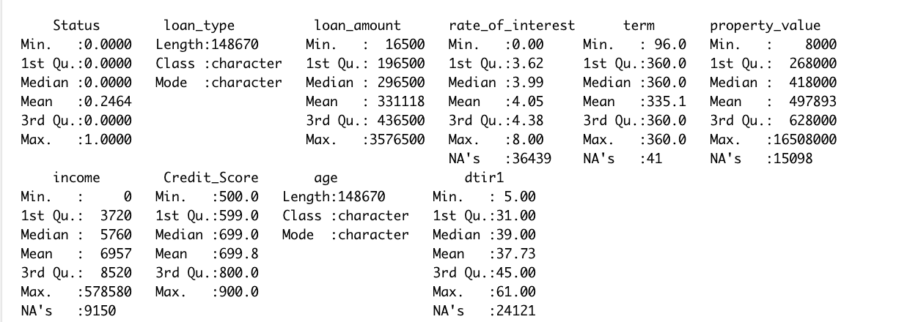
ORIGINAL DATASET

Slide 9
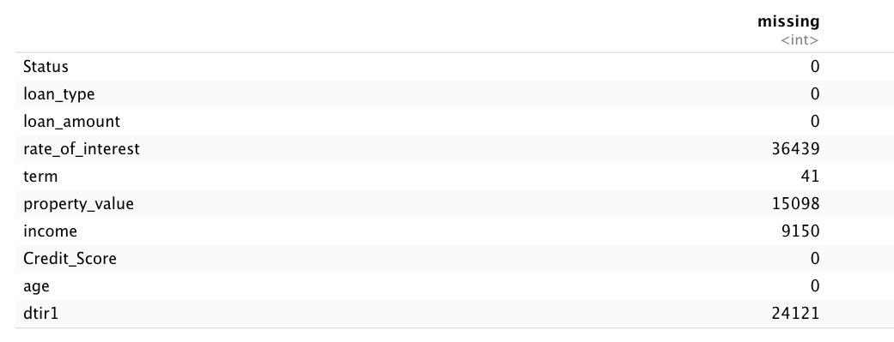
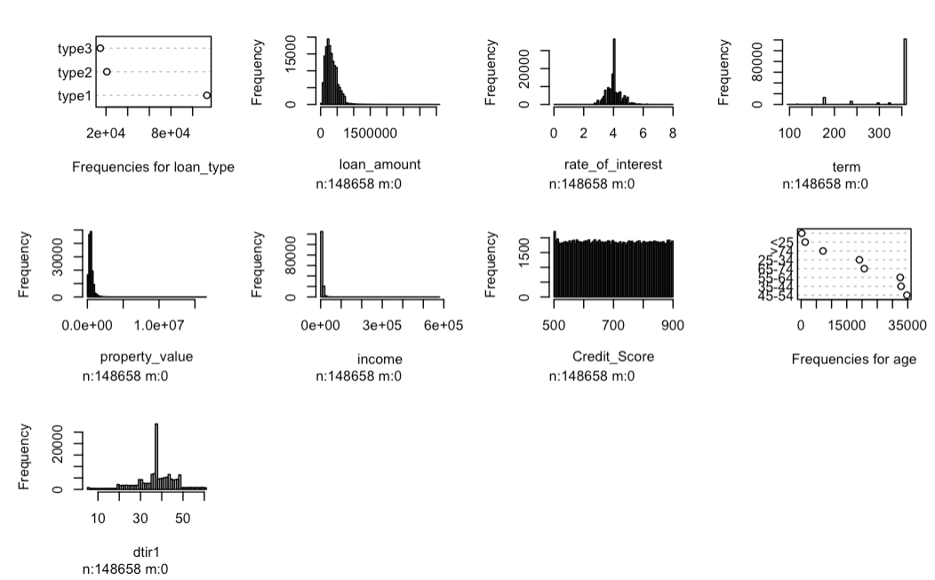
DATA CLEAN UP
IMPUTATION METHODS
OUTLIER DETECTION & REMOVAL
- Q3 + (1.5*IQR) TO REMOVE OUTLIERS
Split our dataset to train 80%, test 20%

Slide 10
AGENDA
PROJECT BACKGROUND
EXPLORATORY DATA ANALYSIS(EDA) AND CLEANUP
VARIABLE SELECTION
LOGISTIC & INTERACTION MODEL
MODEL COMPARISON
CONCLUSION

Slide 11
DATA DESCRIPTION
EXPLANATORY VARIABLE | TYPE | SCALE
Loan_type | CATEGORICAL | NOMINAL
Loan_amount | CATEGORICAL | NOMINAL
Rate_of_interest | NUMERICAL | CONTINUOUS
Term | NUMERICAL | DISCRETE
Property_value | NUMERICAL | CONTINUOUS
Income | NUMERICAL | CONTINUOUS
Credit_Score | NUMERICAL | CONTINUOUS
Age | CATEGORICAL | ORDINAL
Debt-to-income ratio (dtir1) | NUMERICAL | CONTINUOUS

Slide 12
VARIABLE SELECTION
CATEGORICAL
NUMERICAL

Slide 13
VARIABLE SELECTION
CATEGORICAL
TEST: CHI-SQUARE TEST OF INDEPENDENCE
NUMERICAL

Slide 14
VARIABLE SELECTION
CATEGORICAL
NUMERICAL
Normal Data Distribution
Large Sample Size
TEST: TWO-SAMPLE T-TEST
Continuous Data
Random Sample

Slide 15
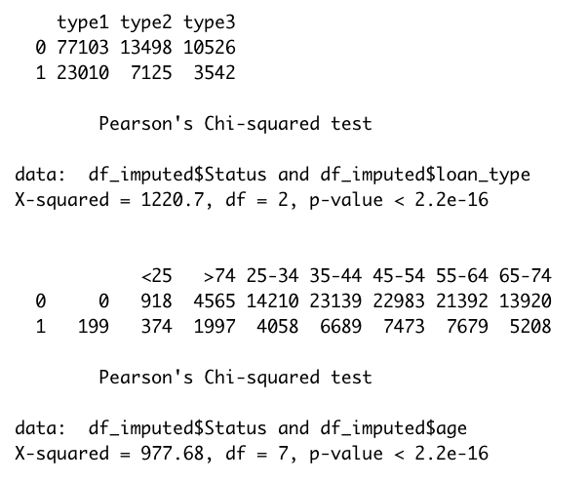
VARIABLE TESTING - CATEGORICAL

Slide 16
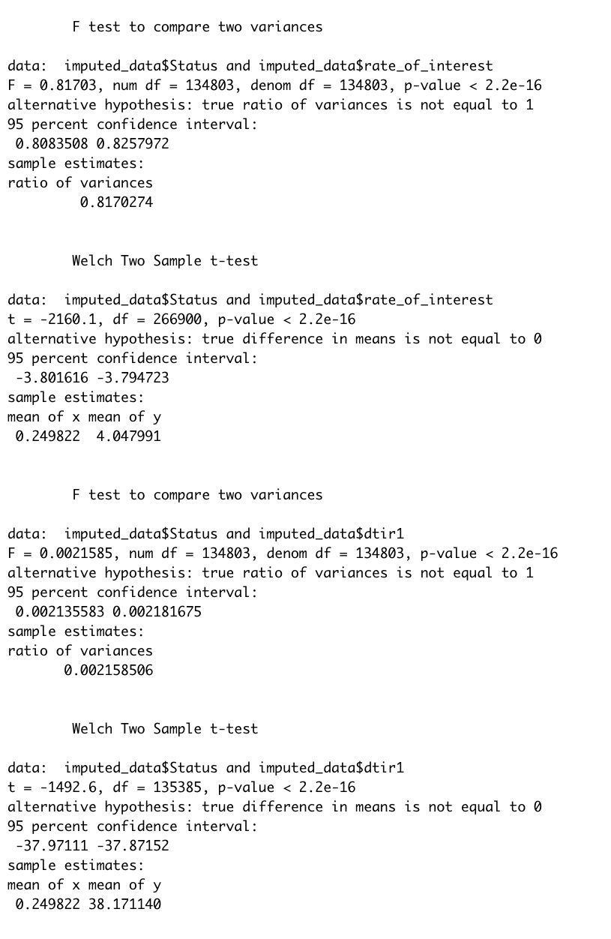
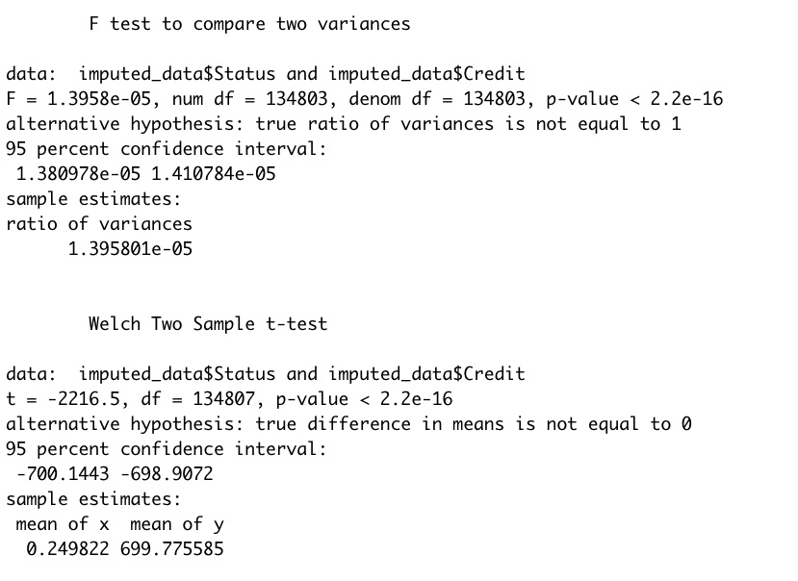
VARIABLE TESTING - NUMERICAL

Slide 17
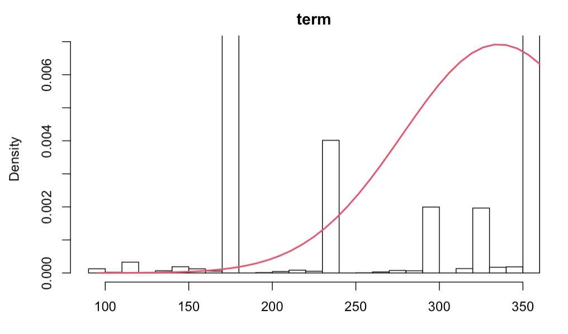
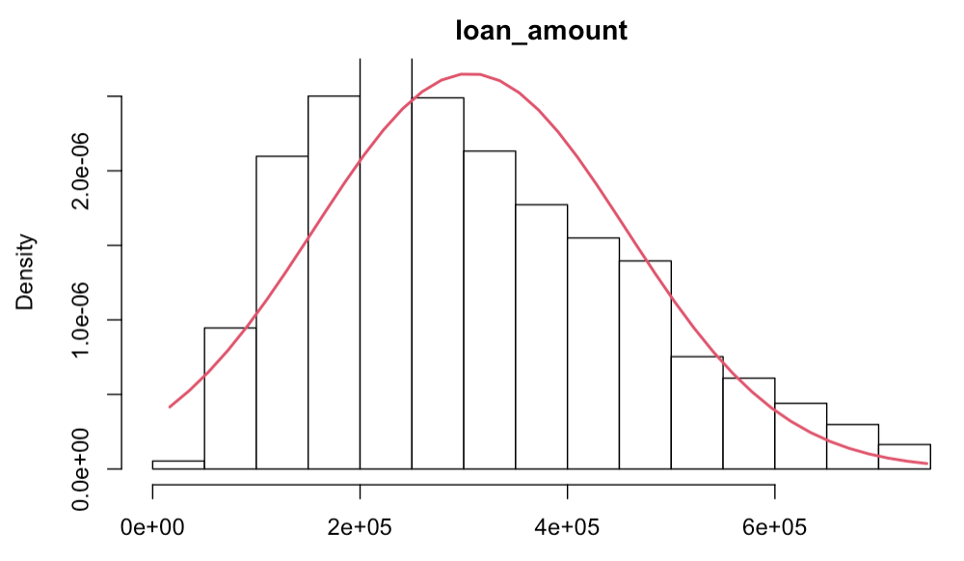
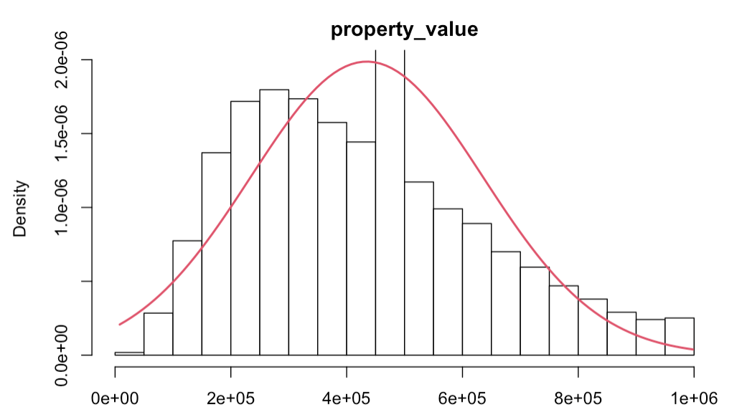
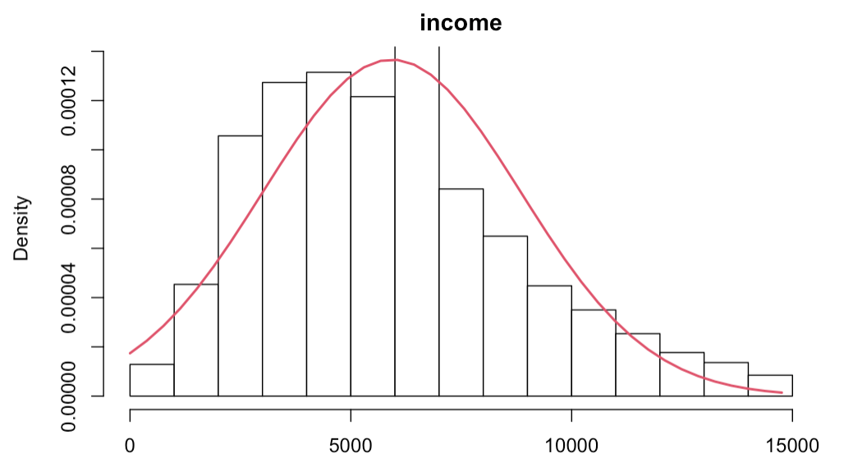
NORMALITY TESTS

Slide 18
AGENDA
PROJECT BACKGROUND
EXPLORATORY DATA ANALYSIS(EDA) AND CLEANUP
VARIABLE SELECTION
LOGISTIC & INTERACTION MODEL
MODEL COMPARISON
CONCLUSION

Slide 19
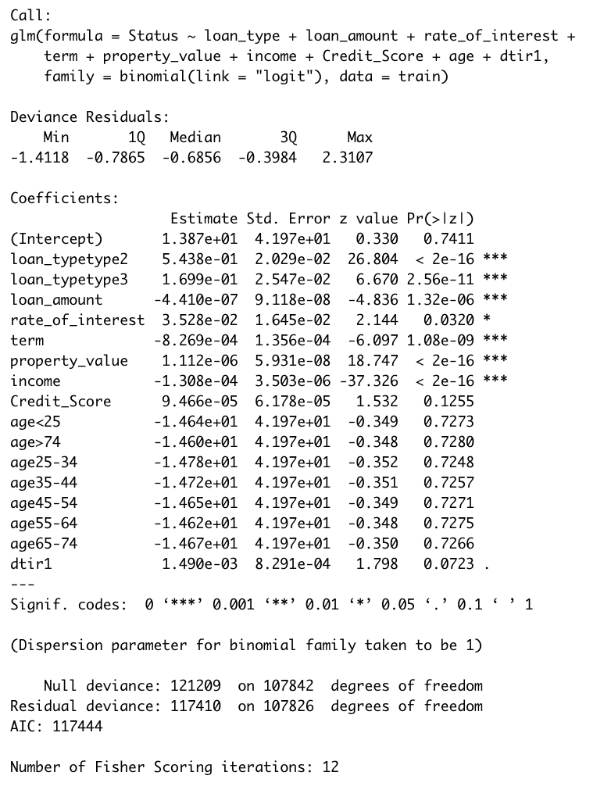
INITIAL MODEL USING TRAIN DATASET

Slide 20
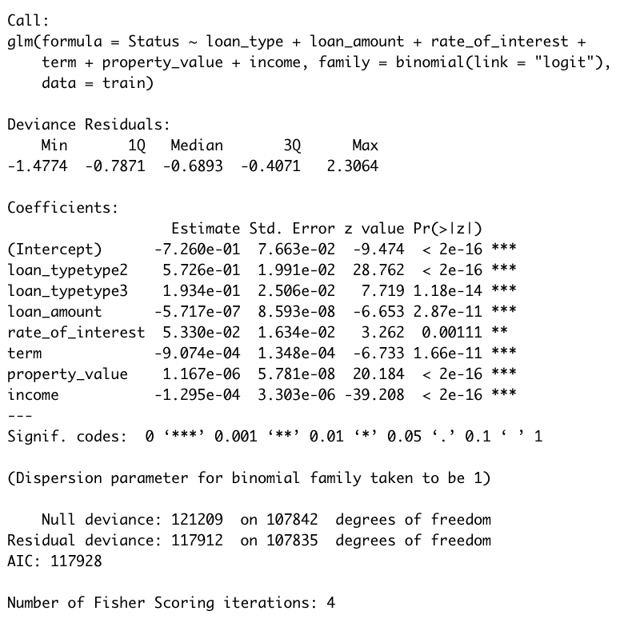
MODEL WITH SIGNIFICANT VARIABLES

Slide 21
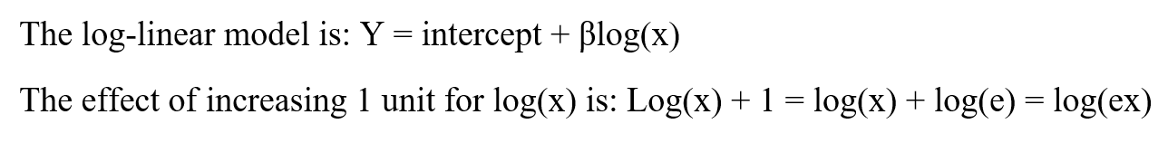
NON-INTERACTION MODEL EQUATION
LOG LINEAR INTERPRETATION
Notes:
Double-check correct equation

Slide 22
Model Results Summary
Factors | Multiplicative Effect
Loan Type: type2 | 1.754
Loan Type: type3 | 1.187
Loan Amount | 1
Rate of Interest | 1.038
Income | 1
Property Value | 1
Notes:
Double check correct beta values

Slide 23
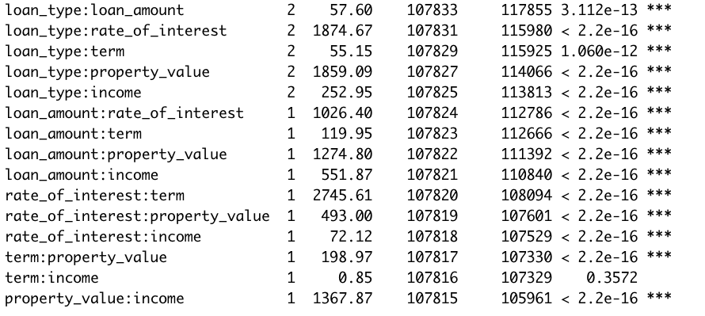
IDENTIFY INTERACTIONS

Slide 24
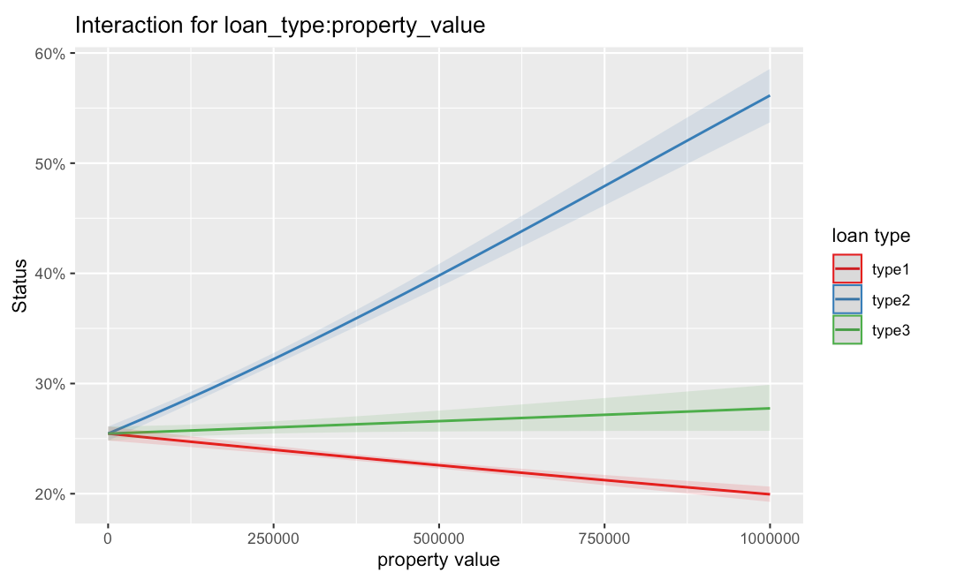
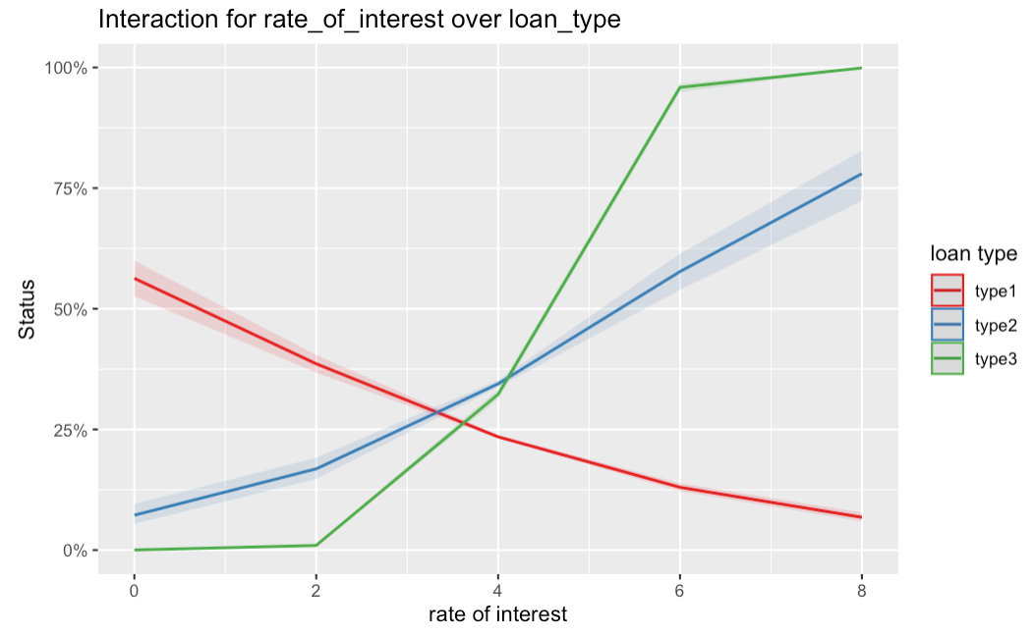
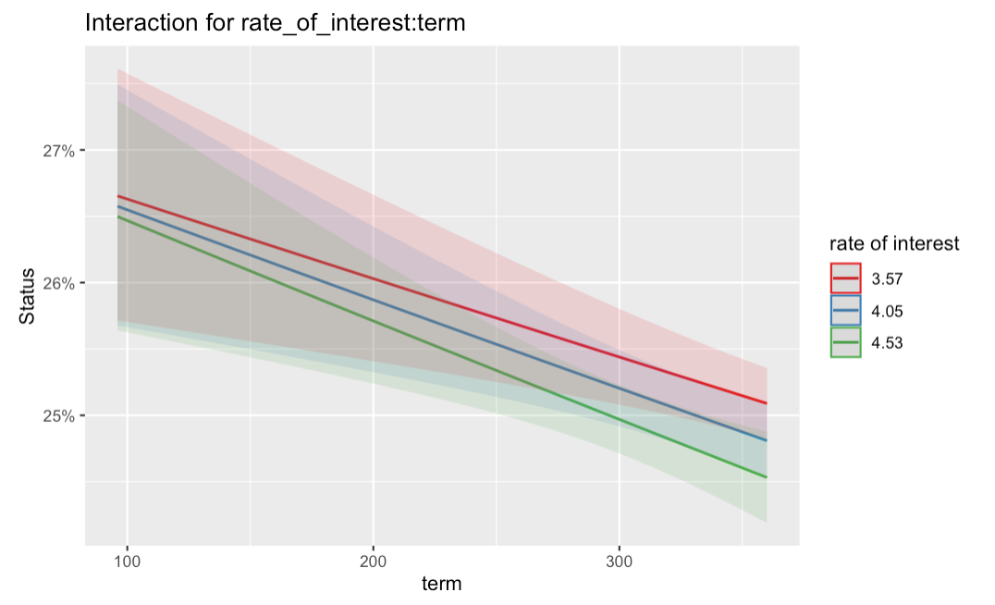
INTERACTION PLOTS

Slide 25
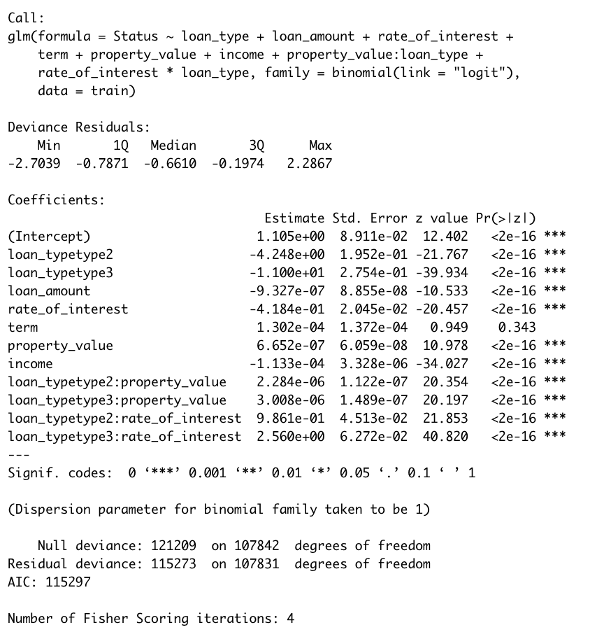
INTERACTION MODEL

Slide 26
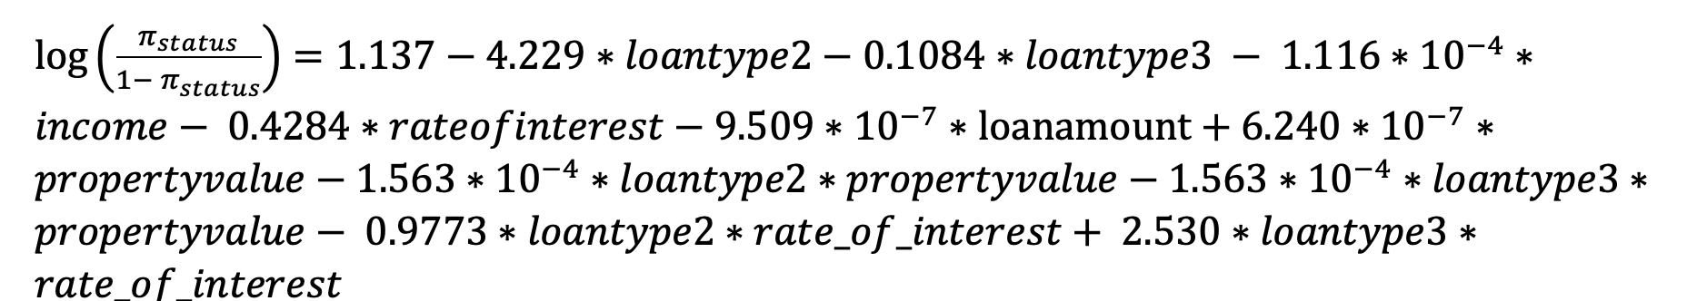
INTERACTION MODEL EQUATION
Notes:
Double-check correct equation

Slide 27
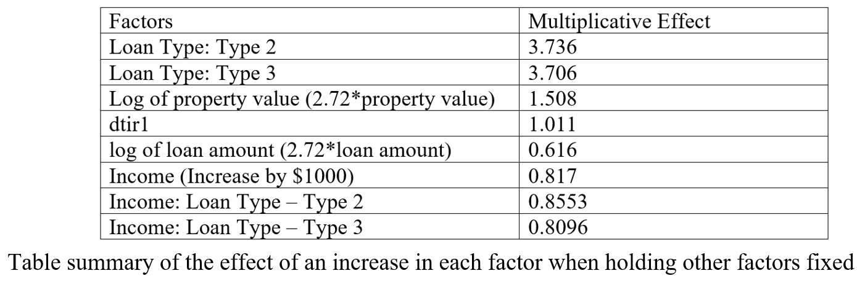
Model Results Summary
Notes:
Double check correct beta values

Slide 28
AGENDA
PROJECT BACKGROUND
EXPLORATORY DATA ANALYSIS(EDA) AND CLEANUP
VARIABLE SELECTION
LOGISTIC & INTERACTION MODEL
MODEL COMPARISON
CONCLUSION

Slide 29
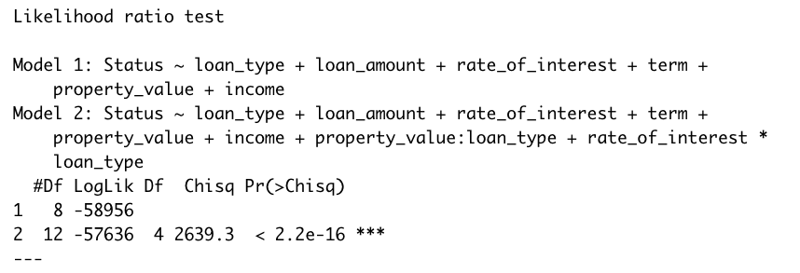
LIKELIHOOD RATIO TEST (INTERACTIVE VS FULL MODEL)
Notes:
Model2 is betetr, which our intraction model

Slide 30
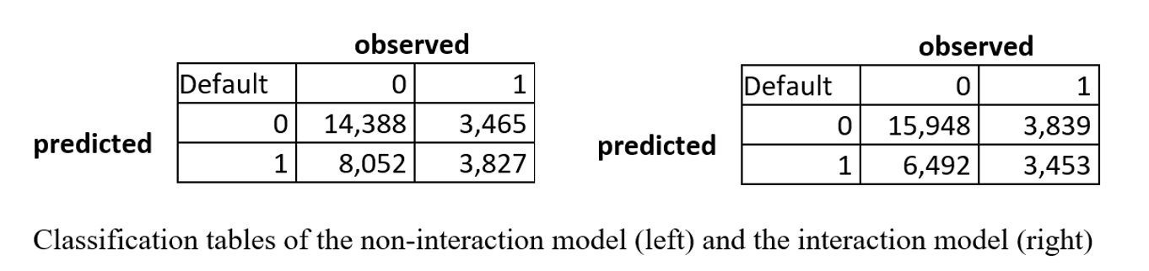
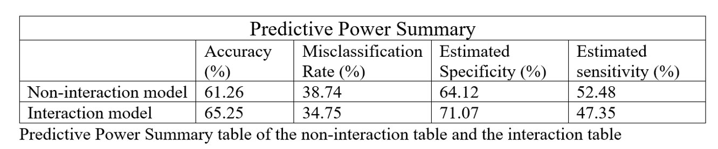
CLASSIFICATION REPORT

Slide 31
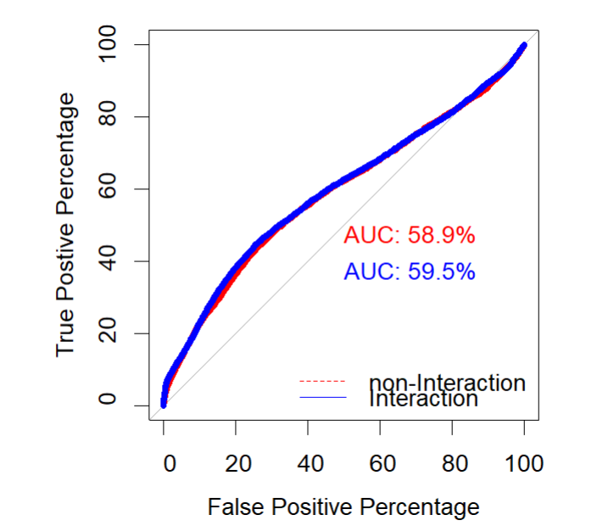
ROC CURVE

Slide 32
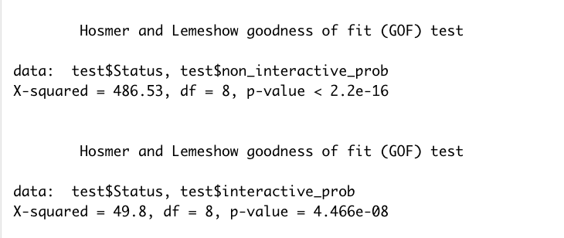
THE HOSMER-LEMESHOW TEST
Notes:
We have a lack of fit, but between the two mdoels the inetractive mdeol is better
Interactve model is good

Slide 33
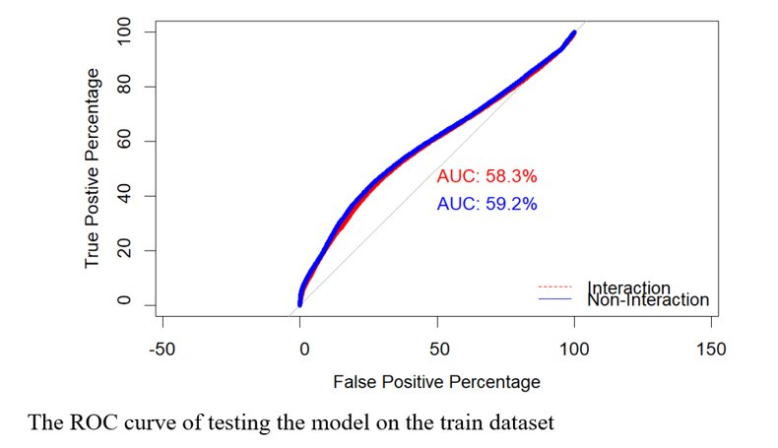
ADDITIONAL EXPERIMENTATION

Slide 34
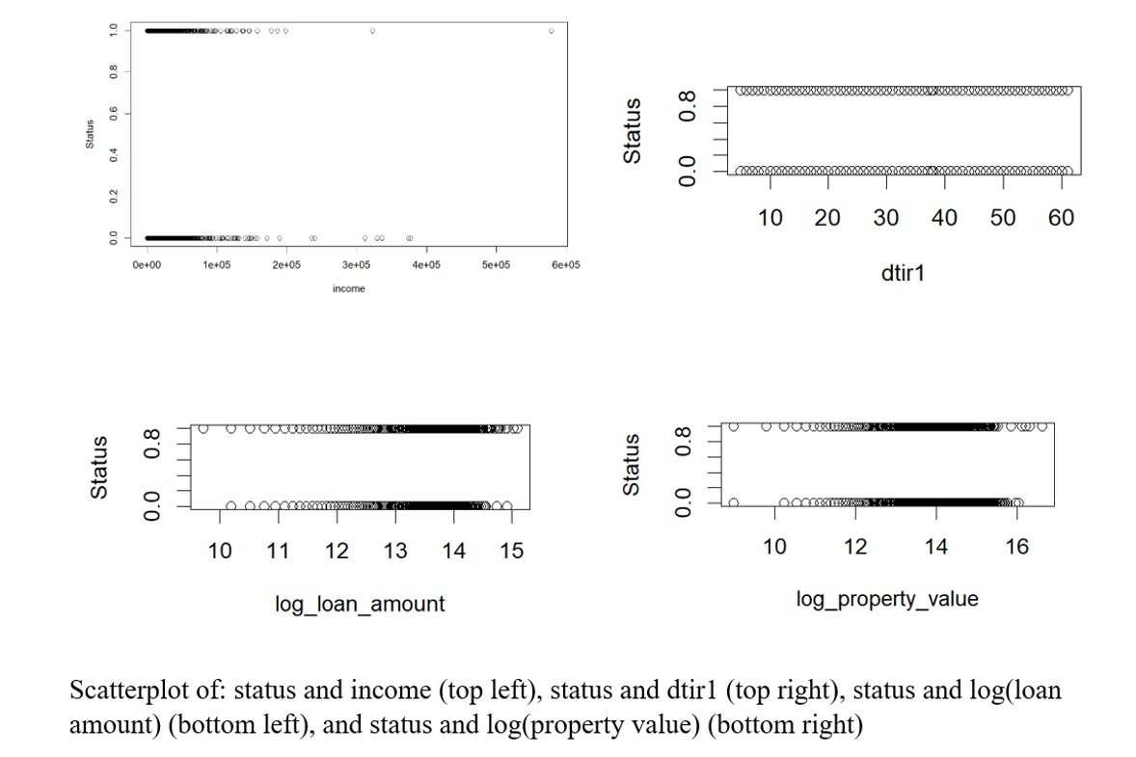

Slide 35
AGENDA
PROJECT BACKGROUND
EXPLORATORY DATA ANALYSIS(EDA) AND CLEANUP
VARIABLE SELECTION
LOGISTIC & INTERACTION MODEL
MODEL COMPARISON
CONCLUSION

Slide 36
CONCLUSION
Useful dataset, reflected real life scenarios​
Initial variable selection was based on domain knowledge​
Less than 10% missing and outlier data

Slide 37
CONCLUSION
Useful data after imputation and outlier cleaning​
Initial model (9 variables) produces 7 significant variables​
Model with significant variables produced valid interactions​
Tests indicated that the model with interaction is better model

Slide 38
CONCLUSION
All factors were in influential in the model
The model was ineffective in predicting loan default status
However, due to the spread of the data points, there was a lack of fit
Initially selected variables passed t-tests and chi-square tests

Slide 39
THANK YOU!

